Slide 1
Feb. 8
LS
10:00 to 16:30 , first batch 40 m³ LS sending to FOC tank
Filling
1m³ LS to CD
18:00-19:30
1.2m³ LS to CD
8:00
12:00
16:00
20:00
0:00
4:00
Run 3691
11:21-11:53
nHit threshold 80, window 80 ns
Run 3697
12:42 - 18:46
nHit threshold 80, window 80 ns
Run 3708
18:53 - 19:22
Run 3709
19:24 - 20:44
LS ton=2.2 m3
nHit threshold 80, window 80 ns
Run 3742
00:58 - 02:04
Run 3743
02:39 - 04:44
Run 3744
05:09 - 09:04
nHit threshold 176, window 224 ns
Physics runs
Calib runs
No action

Slide 2
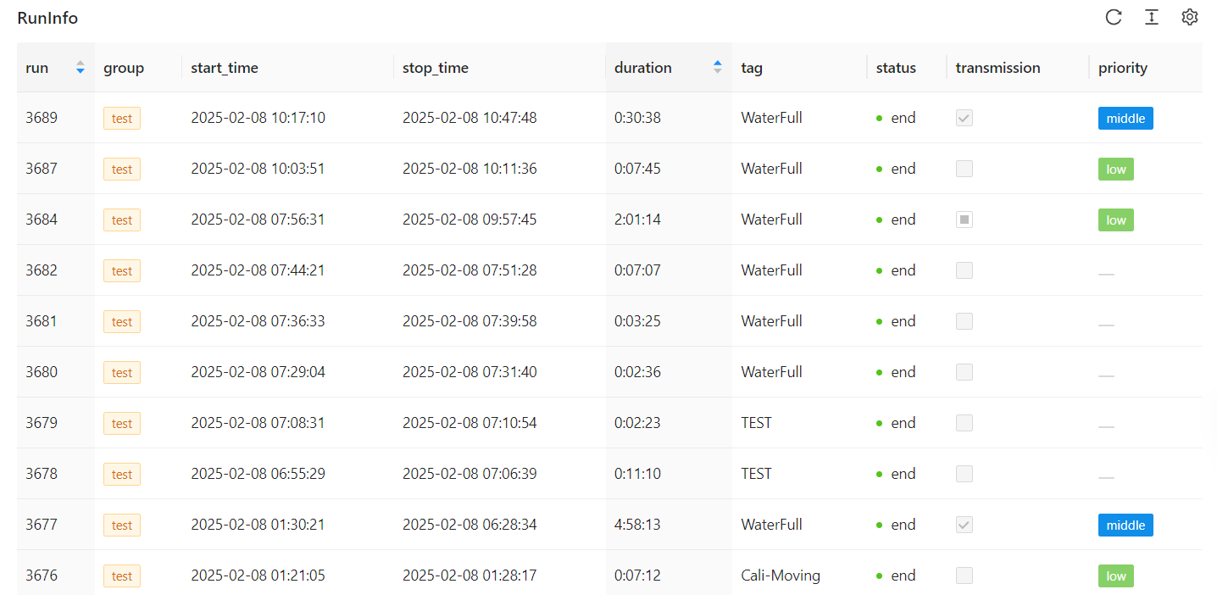
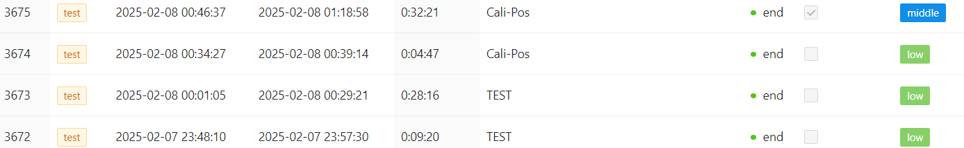

Slide 3
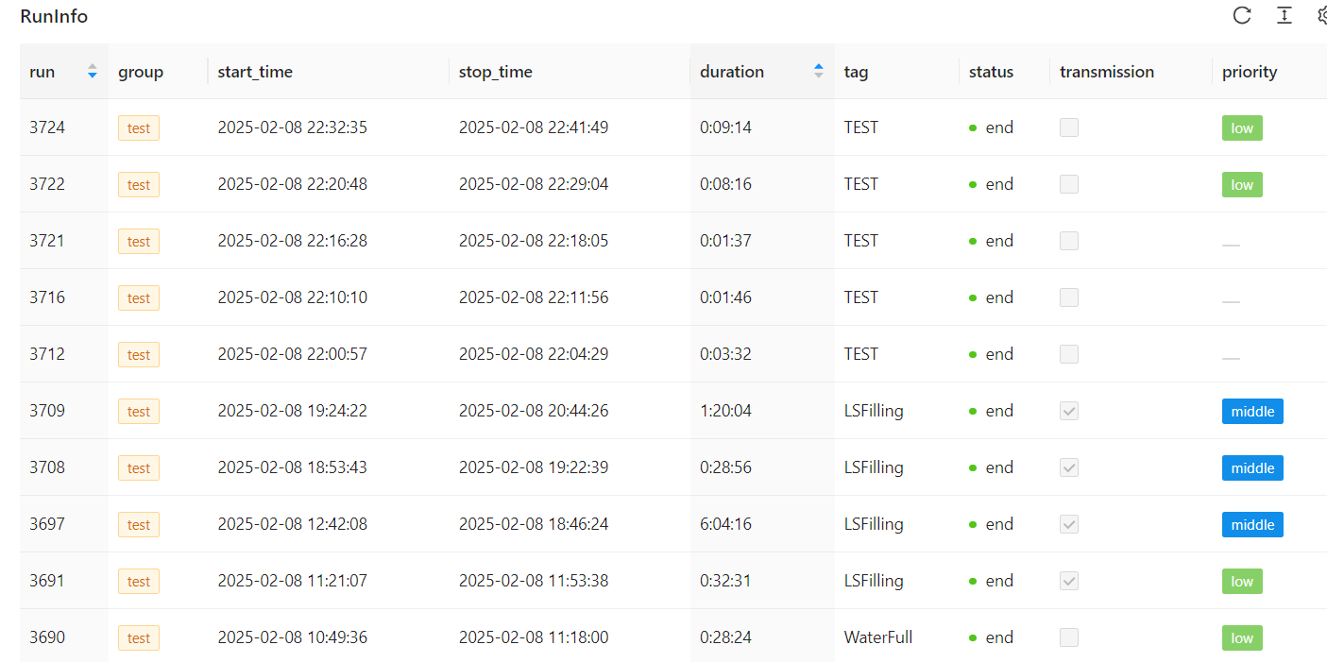

Slide 4
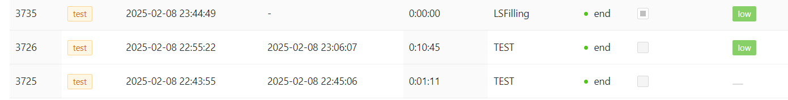

Slide 5
Feb. 9
LS
50 m³ LS go to underground for purification
Filling
10:30-17:42, fill 38m³ to CD
Power off
10:30-14:00
Power off
16:30-18:30
8:00
12:00
16:00
20:00
0:00
4:00
Physics runs
Run 3753 14:40-16:21
nhit threshold 177 in 224 ns LS from 15m³ to 29m³
Run 3793 22:43-07:48
nhit threshold 177 in 224 ns LS 40m³
Run 3749, 3750, AmBe at
18.7m and 18.5m
9:55-10:05；10:08-10:18
nHit threshold 250, window 224 ns
Run 3754/55/57/62 for WP LED calib during 19:03 to 20:36
Calib runs

Slide 6
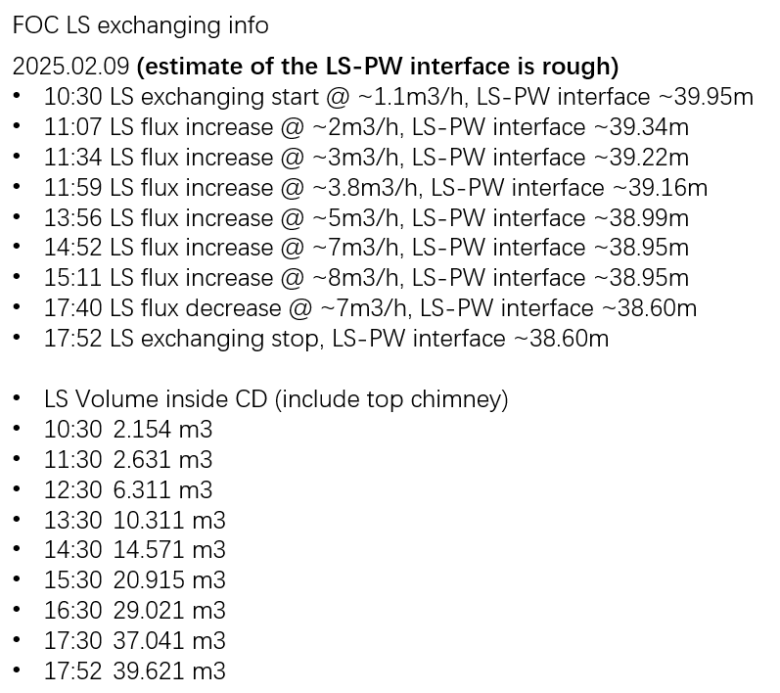

Slide 7
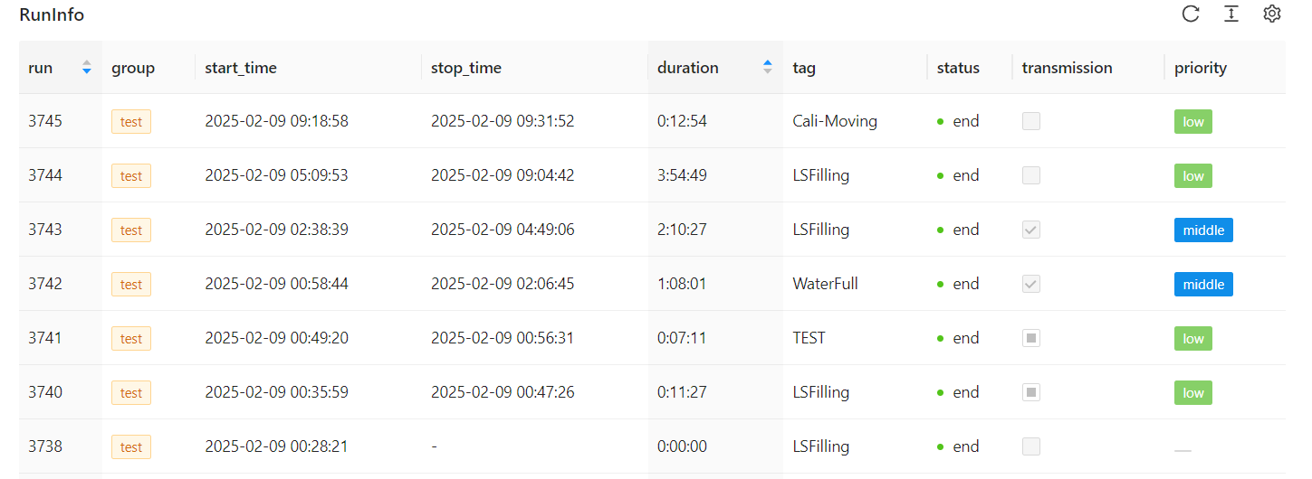

Slide 8
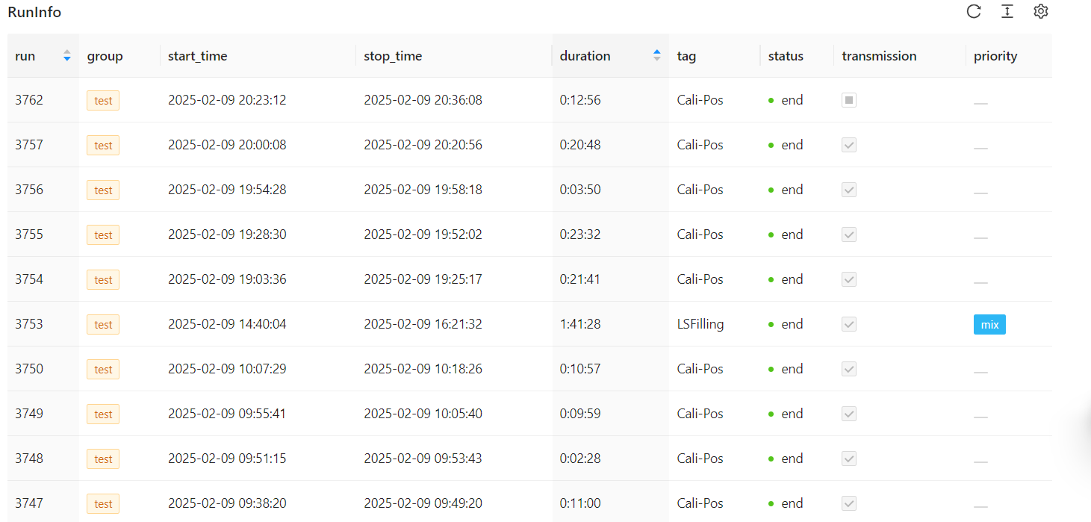

Slide 9
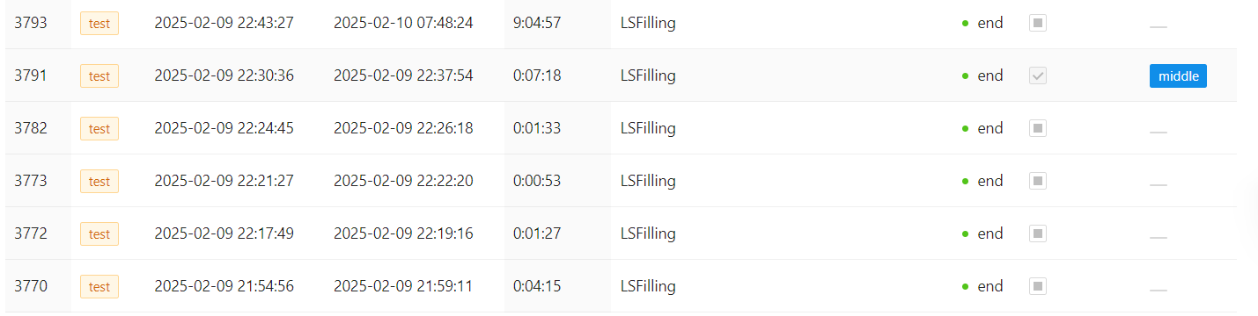

Slide 10
Feb. 10
LS
11:30-19:30, 60m³ new LS go to FOC
Filling
12:30-21:10, fill 60m³ to CD with 7m³/h speed
8:00
12:00
16:00
20:00
0:00
4:00
Run 3840, 11:25~21:20
nHit threshold 177, window 224 ns
Run 3872, 21:30~?
nHit threshold 177, window 224 ns
DAQ
Calib
Run 3811, 3815, AmBe at
22m and 20m
nHit threshold 177, window 224 ns
Run 3818, 3828, 3832, 3834, 3836 AmBe at
17.7, 17.5, 17.3, 17.1 and 16.9m nHit threshold 250, window 224 ns

Slide 11
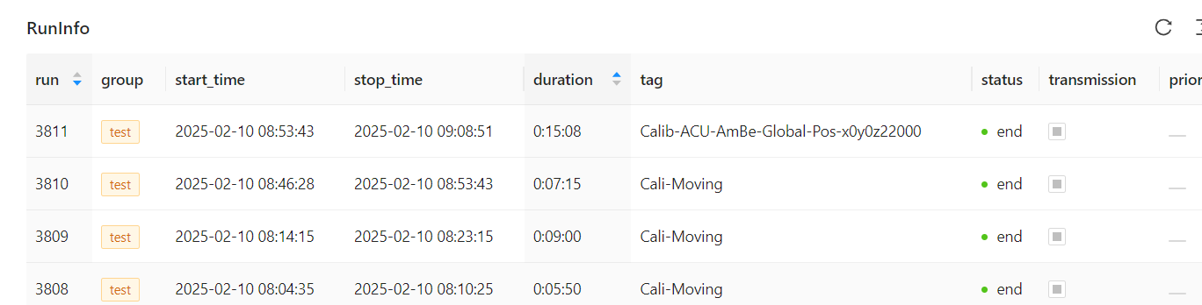
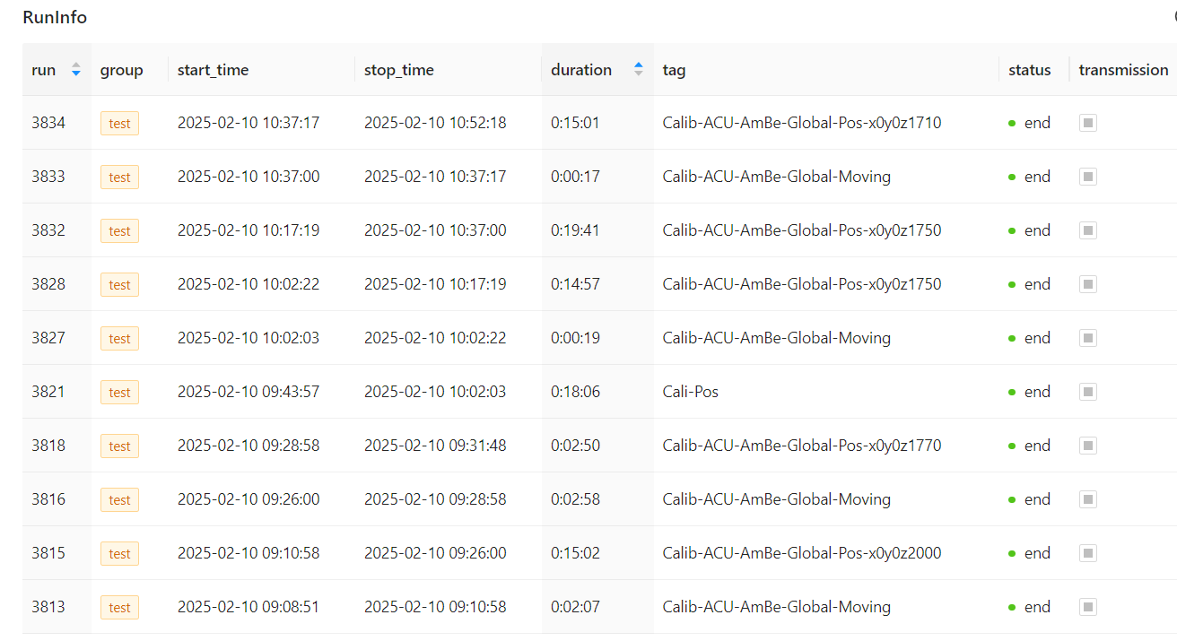

Slide 12
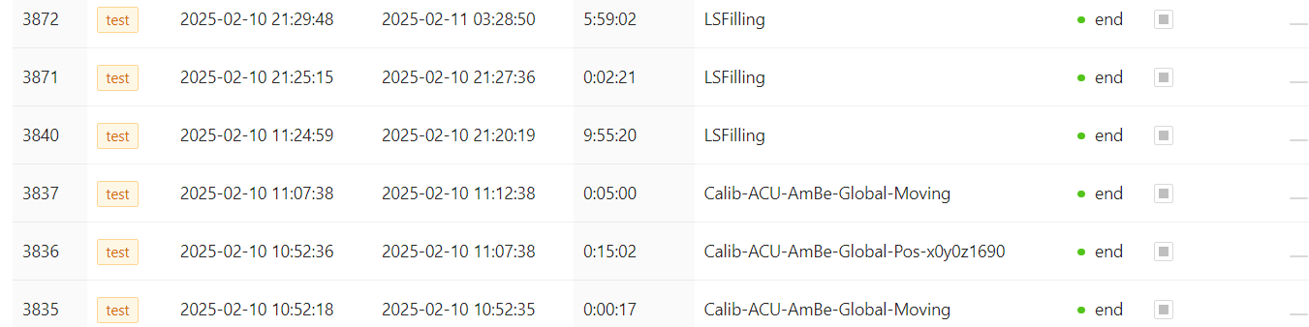

Slide 13
Feb. 11
LS
No action
Filling
8:00
12:00
16:00
20:00
0:00
4:00
Run3872, 2025/02/10 21:30 - 2025/02/11 03:29 LSFilling run, ~100 m3 LS in CD，nHit threshold 177, window 224 ns;
Run 3885 2025/02/11 03:34 -2025/2/11 18:38: LSFilling run, ~100 m3 LS in CD, nHit threshold 177, window 224 ns;
Run 3889 2025-02-11 18:42:53---?
DAQ
.
Calib
02-11 18:04 ACU gate valve closed

Slide 15
Feb. 12
LS
No action
Filling
8:00
12:00
16:00
20:00
0:00
4:00
Run 3889 2025-02-11 18:42:53---2025-02-12 01:09:27 6:26:34
Run 3892 2025-02-12 01:13:23--2025-02-12 01:27:56 0:14:33
Run3903 2025-02-12 21:48:44 2025-02-12 22:04:16 0:15:32
Run3897 2025-02-12 16:23:19 2025-02-12 21:41:48 5:18:29
Run3896 2025-02-12 07:58:49 2025-02-12 16:20:06 8:21:17
Run3903 2025-02-12 21:48:44 2025-02-12 22:04:16 0:15:32
Run3897 2025-02-12 16:23:19 2025-02-12 21:41:48 5:18:29
DAQ
.
Calib
No reaction

Slide 16
